Slide 1

Texas Home Buyers Guide

Slide 2

Main Questions ?
Housing Price: Where are housing prices rising the most in the past 6 years? Where have prices fallen? AKA where do you want to stay away from in your home investment?
COVID transmission: Does the place have higher COVID transmission rate?
Public safety: Is the place safe to live in? What is the crime rate?

Slide 3

Step 1
Identifying Data Source

Slide 4

Data Sources
Housing Price: Zillow Housing Data
https://www.zillow.com/research/data/
COVID transmission: Texas Health and Human service COVID-19 data https://www.dshs.texas.gov/covid-19-coronavirus-disease-2019/texas-covid-19-data
Public safety: Texas Open Data Portal https://data.texas.gov/browse?Dataset-Category_Category-Tile=Public+Safety

Slide 5
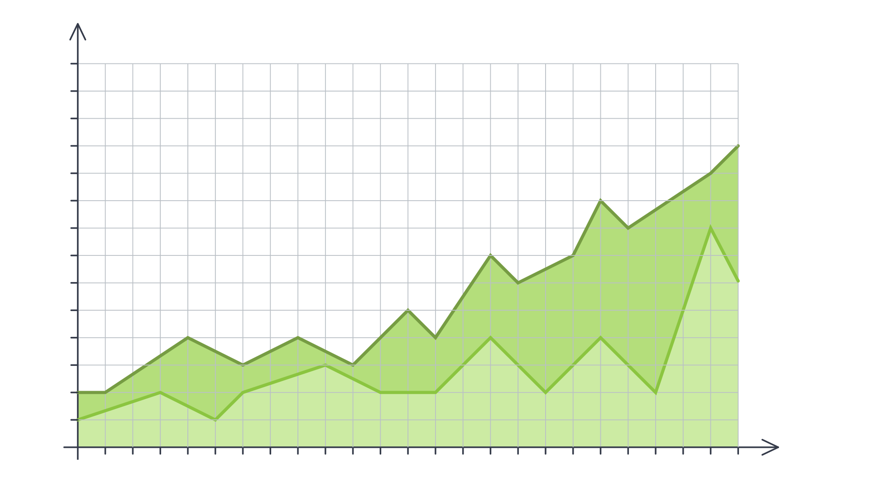
Step 2
Define Strategy and Metrics
100k
95k
80k
85k
80k
75k
70k
65k
60k
55k
50k
45k
40k
35k
30k
25k
20k
1900
1901
1902
1903
1904
1905
1906
1907
1908
1909
1909
1910
1911
1912
1913
1914
1915
1916
1917
1918
1919
1920

Slide 6
Step 2: Define Strategy and Metrics
Here, we created a blueprint for what we’re targeting:
 | How
 | Create
How to achive it | Calculate livability index from 1 to 5 with 1 being lowest and 5 being highest(best) is determined for each of these categories and overall livability grade based on the mean value of these scores is determined for each county

Slide 7
Step 1: Define Strategy and Metrics
Build Data Retrieval Plan and Retrive the Data
Assemble and Clean the Data
Identify trends and Statistical Analysis
Limitations of Analysis and Conclusions

Slide 8
Step 3
100k
95k
80k
85k
80k
75k
70k
65k
60k
55k
50k
45k
40k
35k
30k
25k
20k
1900
1901
1902
1903
1904
1905
1906
1907
1908
1909
1909
1910
1911
1912
1913
1914
1915
1916
1917
1918
1919
1920

Slide 9
COVID Data Analysis
Summary Statistics

Slide 10

Questions ?

Slide 11
Thank you!!!

